Slide 1









EpiMap: Predicting Epigenetic Targets with KG Embedding Models*
Krishna Bulusu
Vishwa Nellore
Sophie Kirschner
Tom Plasterer
HCLS @ KGC 2022
Payal Mitra
Thom Pijnenburg
Ted Slater
May 2, 2022

Slide 2
Today
1
2
3
4
Background: EpiMap –Why and what
Building KGE models for link Prediction
Results & Challenges in KG ML
Applications and Impact

Slide 3
Epigenetics – factors that impact cellular function
Genes encode instructions that are “read” to produce proteins; proteins do most of the physiological work in cells.
Abnormalities in protein synthesis can lead to disease
Genetic causes: mutations, deletions, etc
Epigenetic causes: genes become physically (in)accessible within to transcription machinery.
Why study epigenetics in oncology for target discovery?
Epigenetic changes are prolific in cancer.
Unlike genetic alterations, epigenetic alterations can be reversed.
Design small molecules to reverse harmful epigenetic changes.
Opportunities
>12,000 Epi publications each year.
Unmet need to
Consolidate all epigenetic information.
Use the existing knowledge to identify novel epigenetic targets.
Key strategic pillar for Oncology R&D community.
Image from National Institutes of Health - http://commonfund.nih.gov/epigenomics/figure.aspx

Slide 4
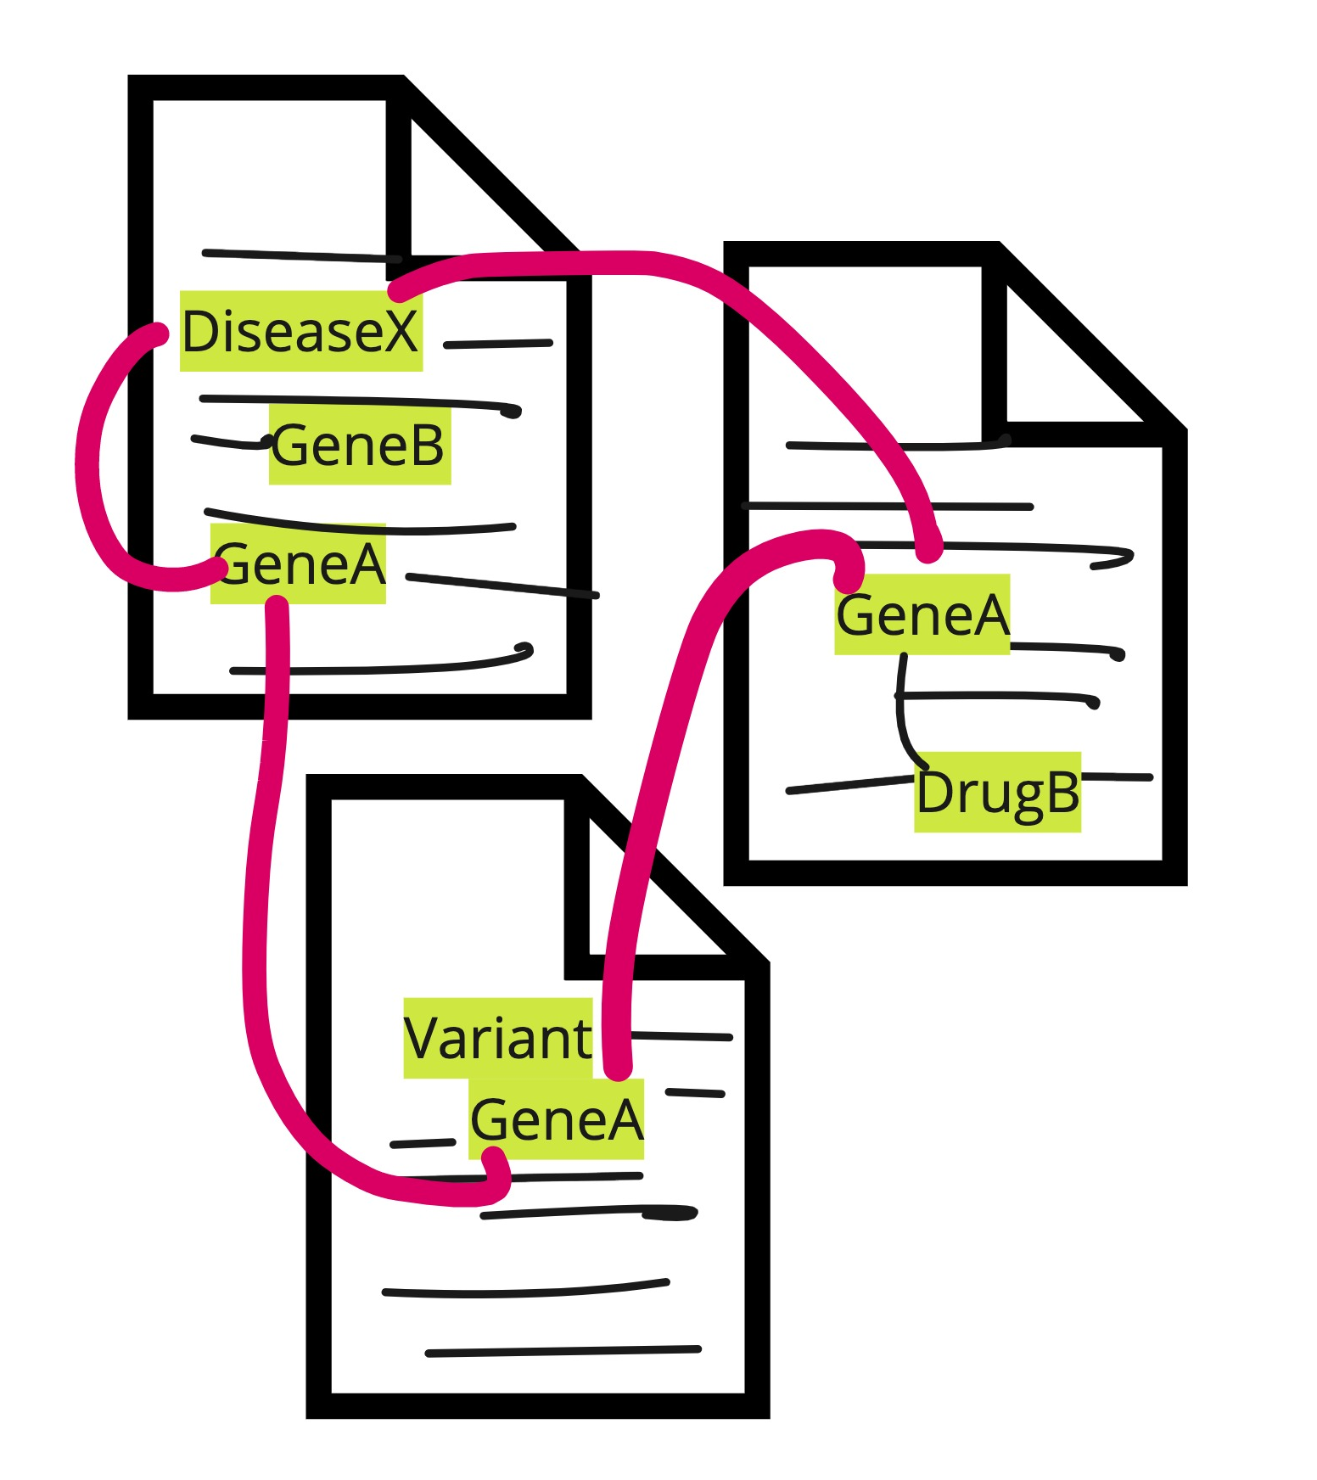
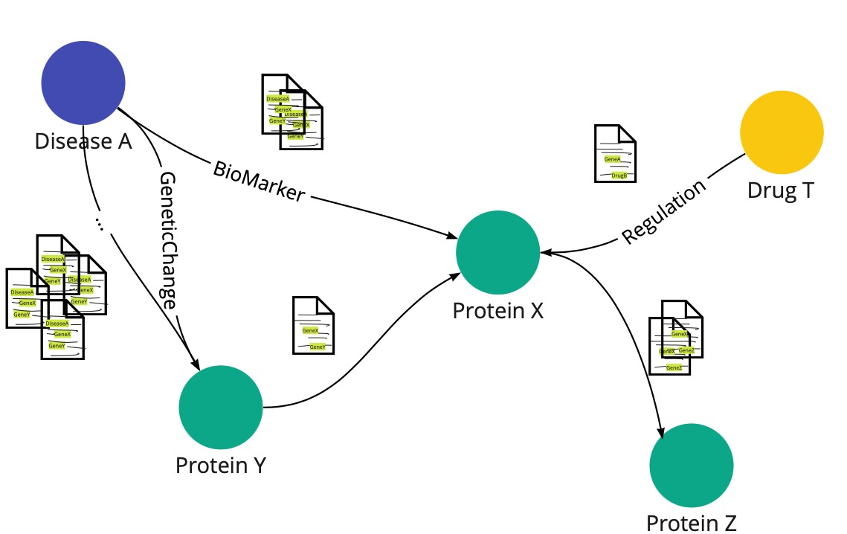
EpiMap KG unlocks Text
The scientific literature contains vast amounts of information relevant to pharmaceutical R&D.
Getting that information out of natural language and into a usable form is a huge challenge, because the scientific community uses different terminologies and formats.
Literature-mined KGs address biological and technological complexity
Inject semantics and represent relations in context, e.g. directionality.
Support multi-hop path traversals, and explainable hypotheses
Capture evolution of knowledge in text-sources.
EpiMap is Elsevier’s Biology Knowledge Graph (“ResNet”) + assertions mined from literature describing epigenetic effects.

Slide 5
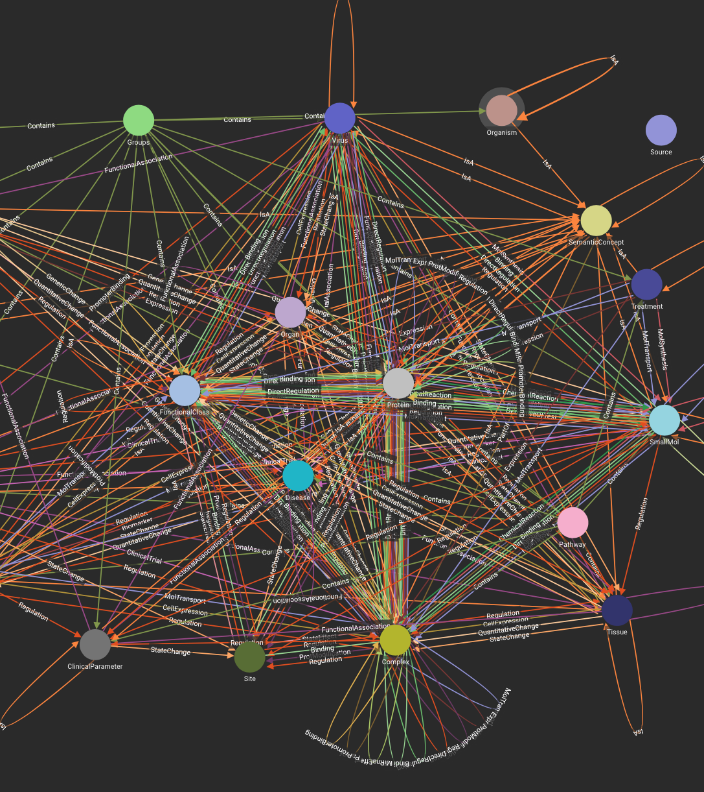
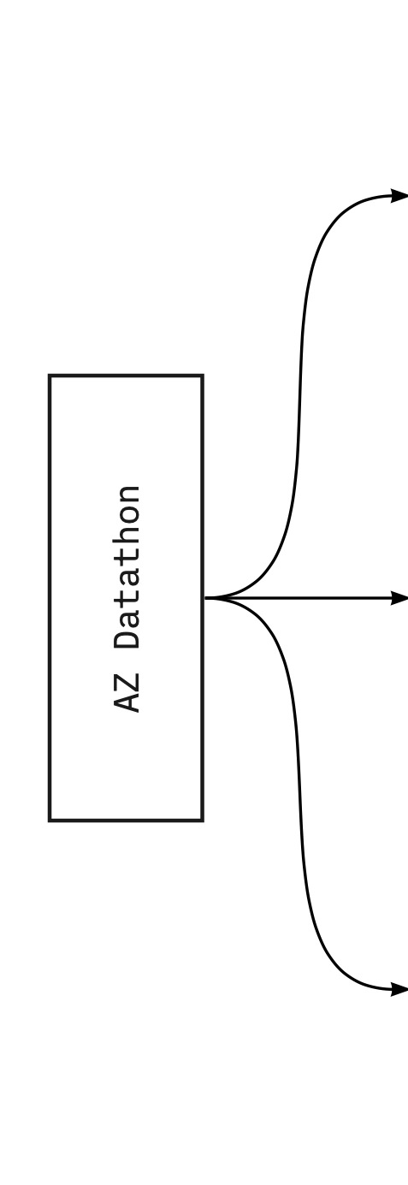
About EpiMap KG
EpiMap KG has ..
1.5M Vertices
13.2M Edges
Extracted from 7M documents
Collaboration with AstraZeneca Oncology with the goal to
Search
for epigenetic mechanisms of disease in oncology.
common epigenetic patterns across disease.
Use ML to predict novel targets.
Discover
Predict

Slide 6
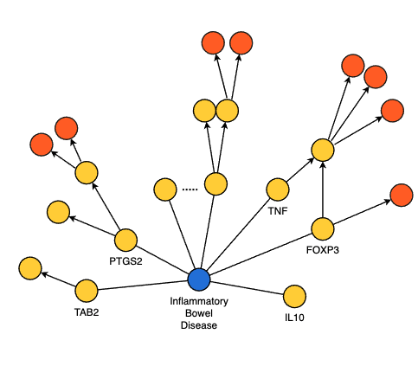
EpiMap KG for Search and Discover
Researcher Q: Could Drug Target Interactions (DTI) with genes that are x hops away from Inflammatory Bowel Syndrome (IBS) potentially regulate IBS? I want to view these DTI paths.
Step 1: # 1hop genes associated to IBS – 256
Step 2: Friends of friends, i.e., 2nd hop genes – 10988
Step 3: Filter only those genes which have known DTIs # Genes - 2477 # DTI Paths – 5891

Slide 7
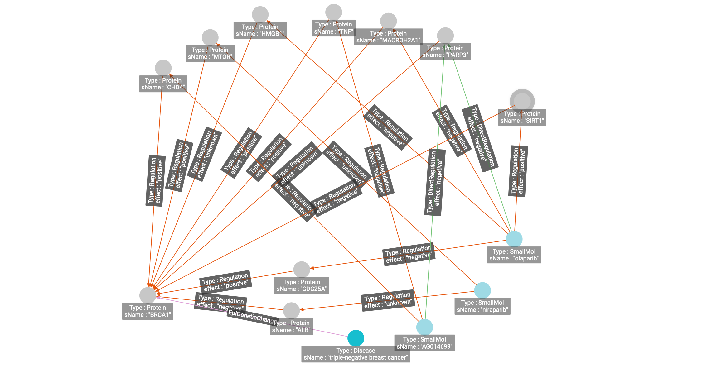
EpiMap provides deep insights into drug activity space
Which Genes co-sensitize to PARP inhibitors in context of disease?
Leverage multi-hop patterns.
Identify alternate ‘directed’ paths driving drug response/resistance.
Generate novel hypotheses informing prospective validation studies.
+
-
TNBC – Triple-Negative Breast Cancer

Slide 8
Today
1
2
3
4
Background: EpiMap –Why and what
Building KGE models for link Prediction
Results & Challenges in KG ML
Applications and Impact

Slide 9
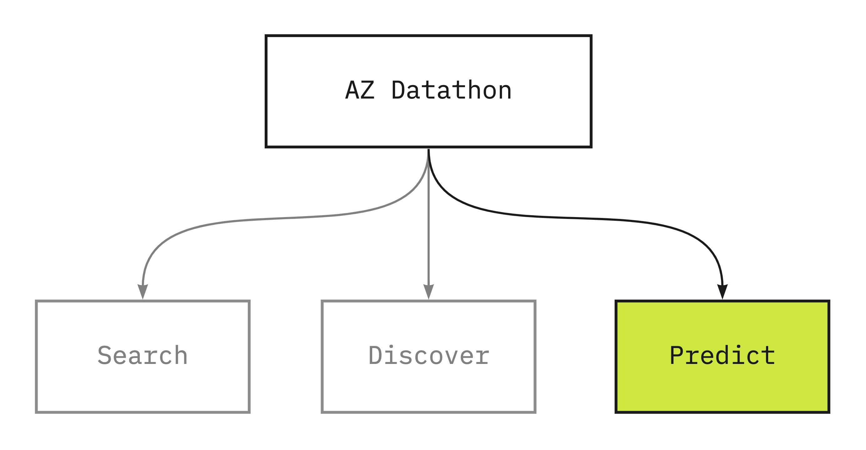
Predicting novel targets using ML
Can we predict potential new targets for specific cancer segments?
This could help researchers in:
Reprioritisation of existing leads.
Identification of new leads.
Apply ML to infer from graph what is important for new link prediction.
How? - Train Knowledge Graph Embedding (KGE) Models to derive vector representations of entities and relations

Slide 10
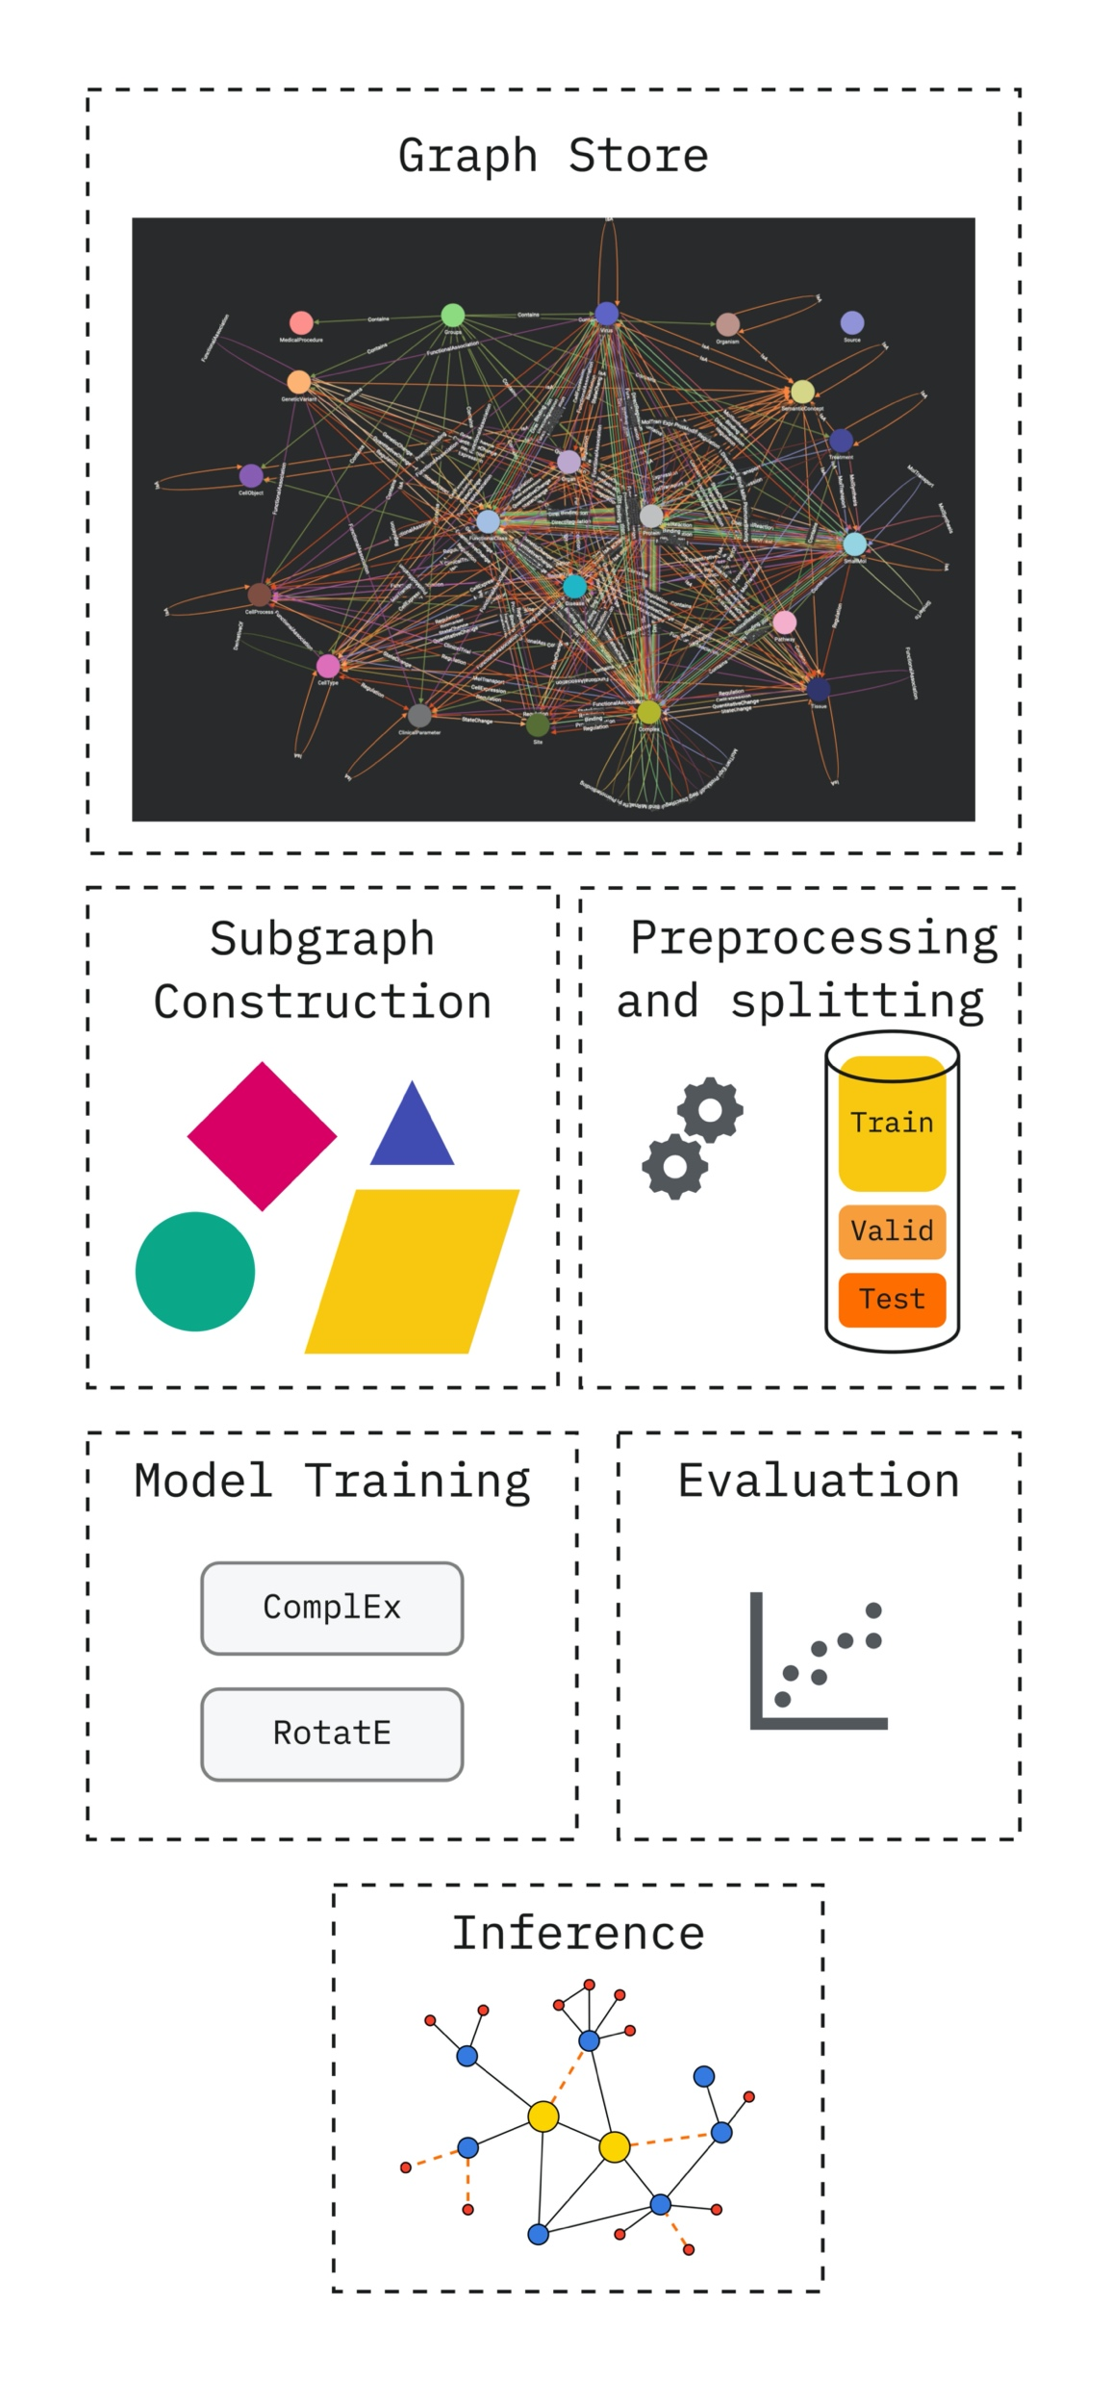
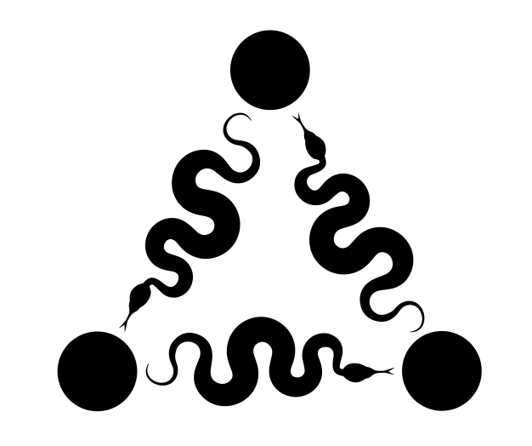
Building KGE models for link prediction
An end to end pipeline for building, selecting and applying KGE models for link prediction*
Data Selection
Model Selection
*Utilised the PyKEEN library to support development Ali, M., Berrendorf, M., Hoyt, C. T., Vermue, L., Sharifzadeh, S., Tresp, V., & Lehmann, J. (2021). PyKEEN 1.0: A Python Library for Training and Evaluating Knowledge Graph Embeddings. Journal of Machine Learning Research, 22(82), 1–6. Retrieved from http://jmlr.org/papers/v22/20-825.html
PyKEEN

Slide 11
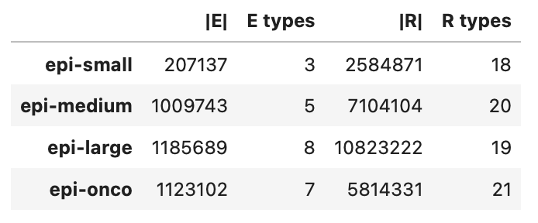
Data selection – Subgraph variants
Full graph contains
1.5M vertices
Include entities like protein, disease, but also processes, locations and groups (e.g. cell death, liver, complex)
13.2M edges (66.8M supporting references)
Physical interactions, disease/cell processes, gene expression
KGE models learn from triples, we have the freedom to choose what entities and relations to include
Concise vs all-encompassing graphs
Focus models on specific processes, e.g. PPI
Isn’t more data always better?
* E=entities; R=relations

Slide 12

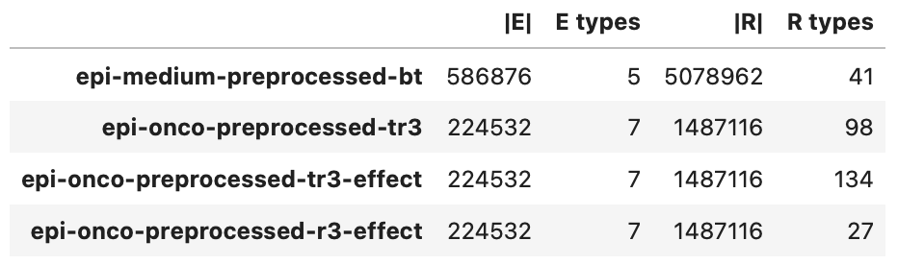


Data selection - Preprocessing
Number of relations
Training samples per relation
Control granularity with various encodings
Can we make vague patterns more explicit?
Trade-off granularity vs n_rels vs n_train
Control confidence or FP rate with refcount filter
Granularity

Slide 13
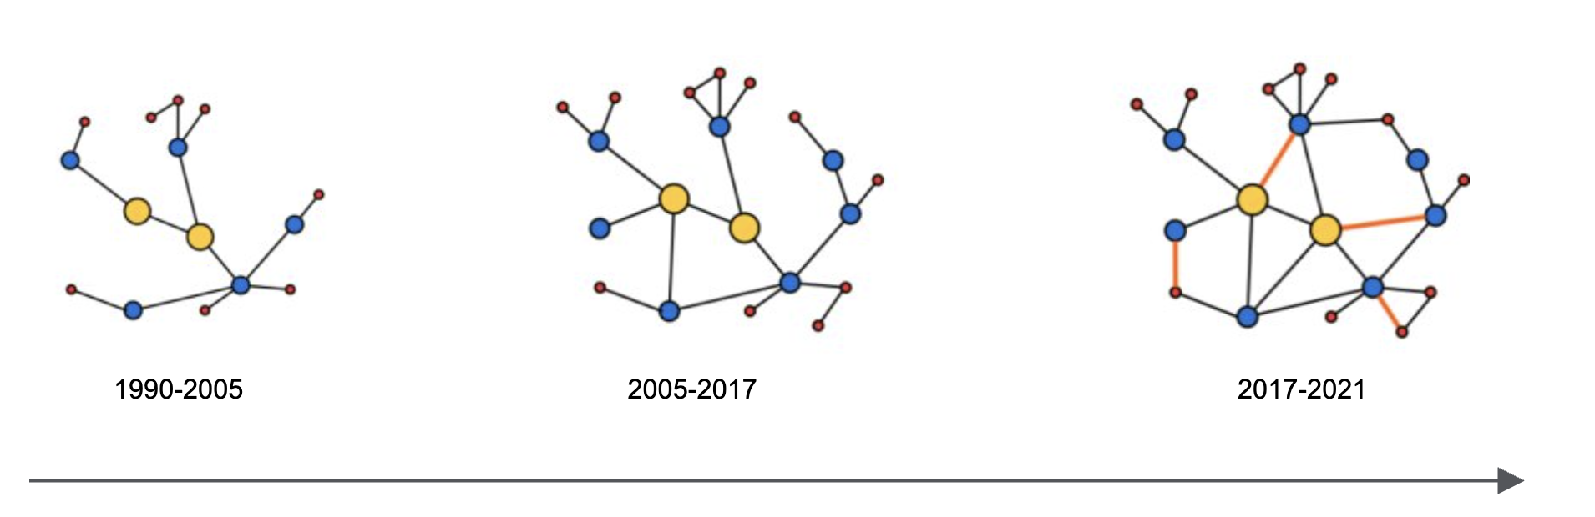
Model Selection - Data splitting and evaluation
Evaluation procedure
Task holdout (disease target prediction) across all models and subgraphs
Per subgraph 90/5/5 train/valid/test split
Corroborate predictions with OpenTargetsPlatform
Option to split
Randomly
Time-based
Metrics from Information Retrieval
Hits@k
Variations of mean rank, e.g. Inverse Arithmetic Mean Rank (IAMR) - (0, 1]
Evaluate models on hard task: all entities in context of all relations.
New metrics pop up (Berrendorf et al., 2020)
Berrendorf, M., Faerman, E., Vermue, L., & Tresp, V. (2020). On the Ambiguity of Rank-Based Evaluation of Entity Alignment or Link Prediction Methods. arXiv. https://doi.org/10.48550/ARXIV.2002.06914

Slide 14
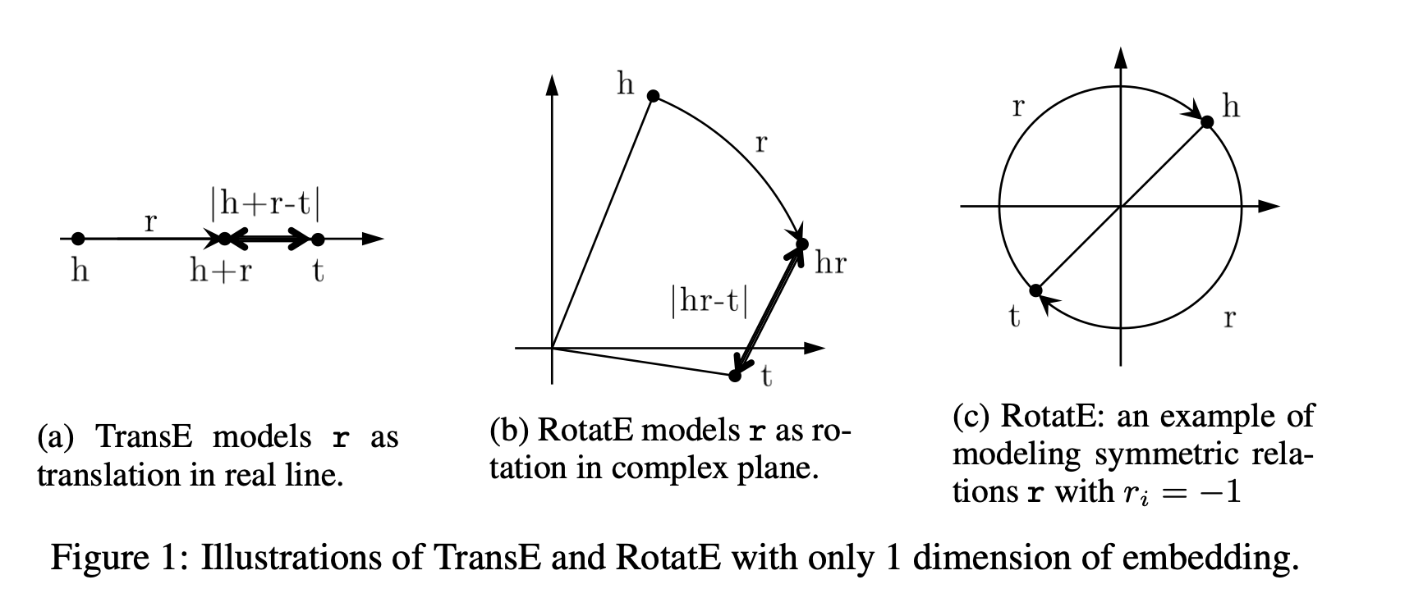
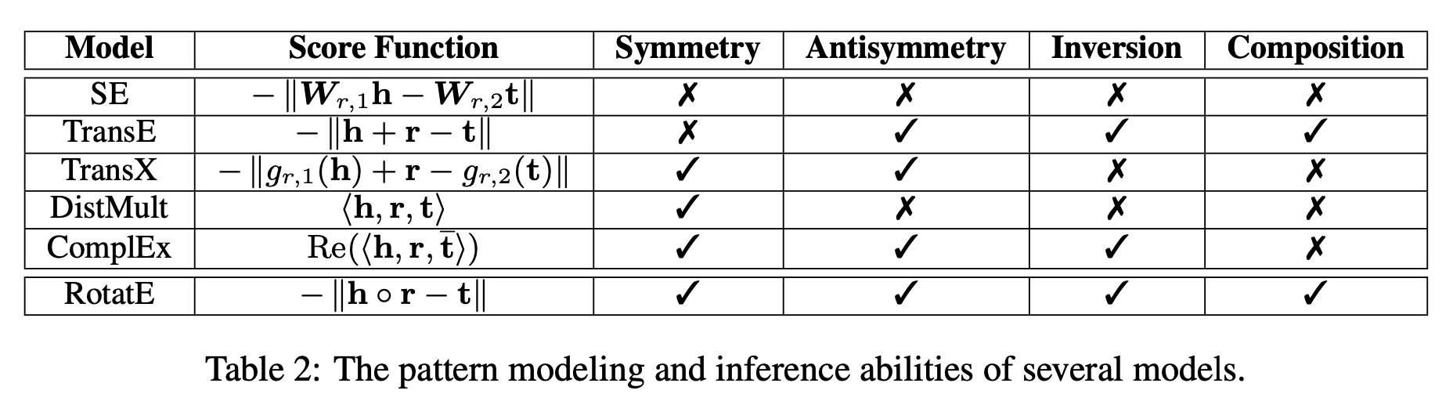
Model Selection - KG Embedding Models
KG Embeddings (KGE) derive vector representations of entities and relations in the graph.
Scores and ranks all possible entities by their likelihood of completing the link { head, rel, ??? }.
Lookup embeddings with enforced structure through scoring function, e.g. TransE vs ComplEx vs RotatE.
TransE: Bordes, A., Usunier, N., Garcia-Durán, A., Weston, J., & Yakhnenko, O. (2013). Translating Embeddings for Modeling Multi-Relational Data. In Proceedings of the 26th International Conference on Neural Information Processing Systems - Volume 2 (pp. 2787–2795). Red Hook, NY, USA: Curran Associates Inc.
ComplEx: Trouillon, T., Welbl, J., Riedel, S., Gaussier, É., & Bouchard, G. (2016). Complex Embeddings for Simple Link Prediction. arXiv. https://doi.org/10.48550/ARXIV.1606.06357
Resources from: Sun, Z., Deng, Z.-H., Nie, J.-Y., & Tang, J. (2019). RotatE: Knowledge Graph Embedding by Relational Rotation in Complex Space. arXiv. https://doi.org/10.48550/ARXIV.1902.10197
Notes:
From RotatE paper:
and widely spread in knowledge graphs: symmetry, inversion and composition. We give their formal definition here:
Definition 1. A relation r is symmetric (antisymmetric) if ∀x, y r(x,y) ⇒ r(y,x) ( r(x,y) ⇒ ¬r(y,x) )
A clause with such form is a symmetry (antisymmetry) pattern. Definition 2. Relation r1 is inverse to relation r2 if ∀x, y
r2(x, y) ⇒ r1(y, x) A clause with such form is a inversion pattern.
Definition 3. Relation r1 is composed of relation r2 and relation r3 if ∀x, y, z r2(x, y) ∧ r3(y, z) ⇒ r1(x, z)
A clause with such form is a composition pattern.
FB15k (Bordes et al., 2013) is a subset of Freebase (Bollacker et al., 2008), a large-scale knowledge graph containing general knowledge facts. Toutanova & Chen (2015) showed that almost 81% of the test triplets (x, r, y) can be inferred via a directly linked triplet (x, r′ , y) or (y, r′ , x). Therefore, the key of link prediction on FB15k is to model and infer the symmetry/antisymmetry and inversion patterns.
WN18 (Bordes et al., 2013) is a subset of WordNet (Miller, 1995), a database featuring lexical relations between words. This dataset also has many inverse relations. So the main relation patterns in WN18 are also symmetry/antisymmetry and inversion.
FB15k-237 (Toutanova & Chen, 2015) is a subset of FB15k, where inverse relations are deleted. Therefore, the key of link prediction on FB15k-237 boils down to model and infer the symmetry/antisymmetry and composition patterns.
WN18RR (Dettmers et al., 2017) is a subset of WN18. The inverse relations are deleted, and the main relation patterns are symmetry/antisymmetry and composition.

Slide 15
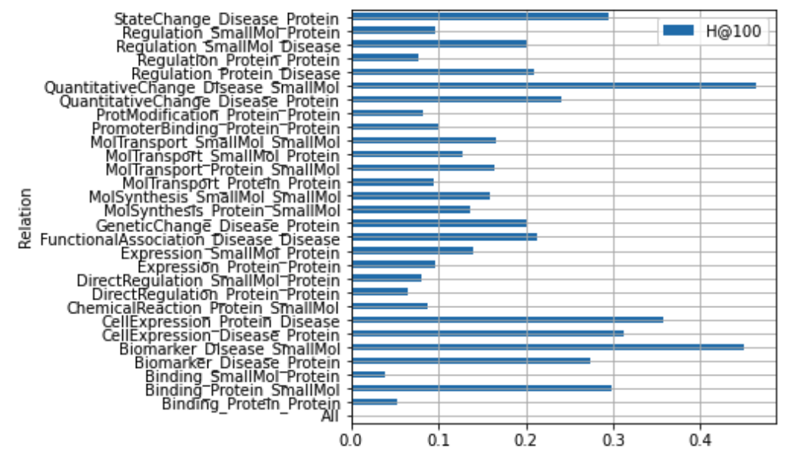
Model Selection - Results and nuances
Choice of meaningful metric on single model
Tadeoff between Link Prediction training objective and end-task specificity
Link Prediction KGE models are trained to learn embedding representations of KG entities and relations such that they can predict ‘all’ relations in context of each other, and not singular relation task
However, end task favours selecting model based on performance of predicting disease-gene association relations only
Metric type
Ranking and information retrieval metrics used, and not classification metrics of PRF
Graph density influences prediction performance -> Model is better at predicting ranks of high-degree nodes in test set, rather than in sparser regions?

Slide 16
Model Selection - Results and nuances
Choice across models trained with different subgraph and algorithm variants
IAMR on validation split (Larger is better)
Hits@100 on validation split (Larger is better)
Training curves
Recall Vs. Rank (AUC – ROC) on Test split
Observations
Oncology specific smaller subgraph > larger subgraphs
RotatE > ComplEx for our data
Is this a consequence of structure in underlying data model?
Proxy measures indicate underlying data model to have xx extent of composition relations
Recall Vs Rank curves

Slide 17
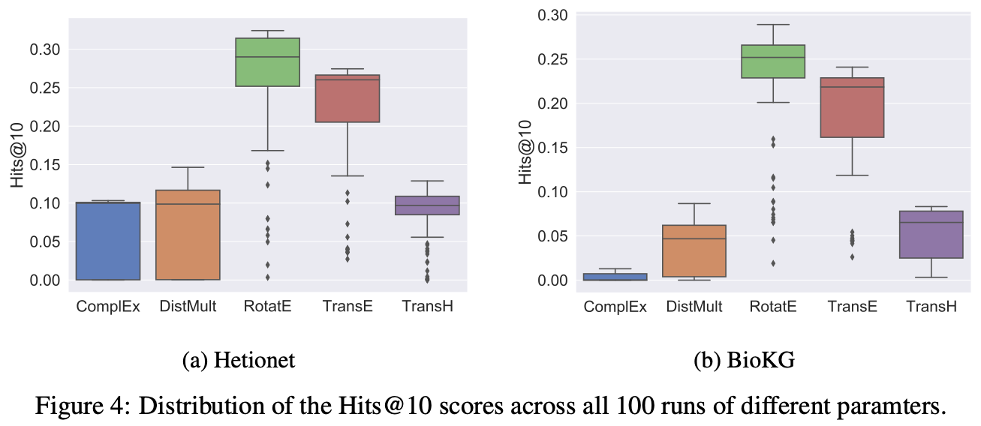
Model Selection - Hyperparameter optimisation
KGE models very sensitive to training setup, hyperparameters, parameter initialisation seeds and different splits in the dataset. (Bonner et al., 2021)
Need to experiment A LOT
Can we be smart about how we expend computational budget?
Bonner, S., Barrett, I.P., Ye, C., Swiers, R., Engkvist, O., Hoyt, C.T., Hamilton, W.L.: Understanding the performance of knowledge graph embeddings in drug discovery (2021). https://doi.org/10.48550/ARXIV.2105.10488, https://arxiv.org/abs/2105.10488

Slide 18
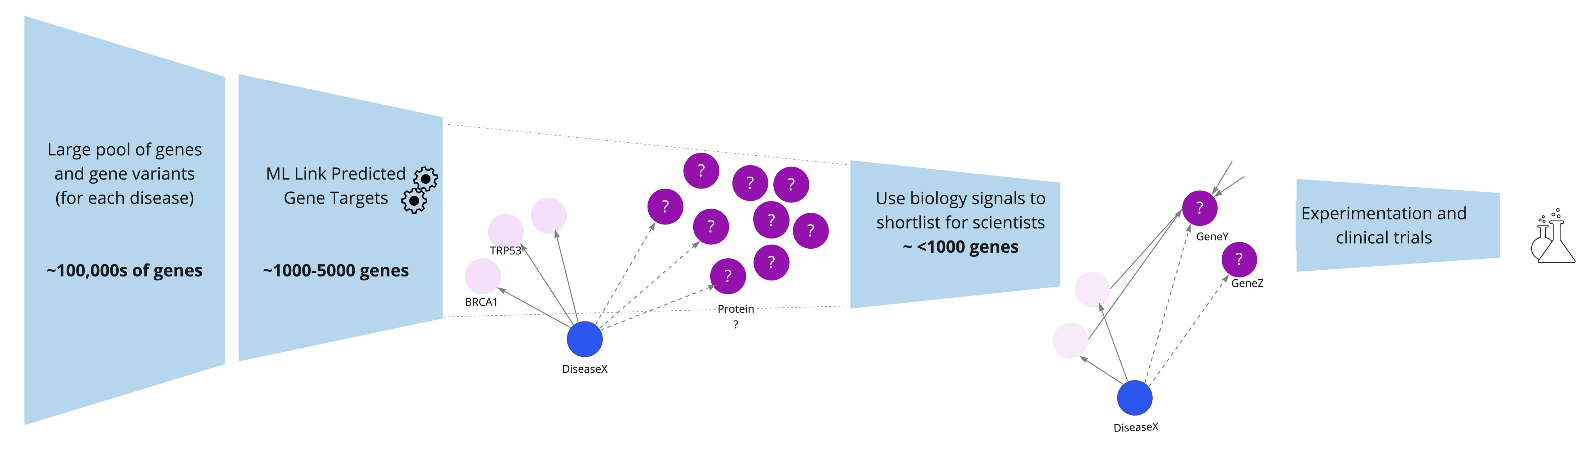
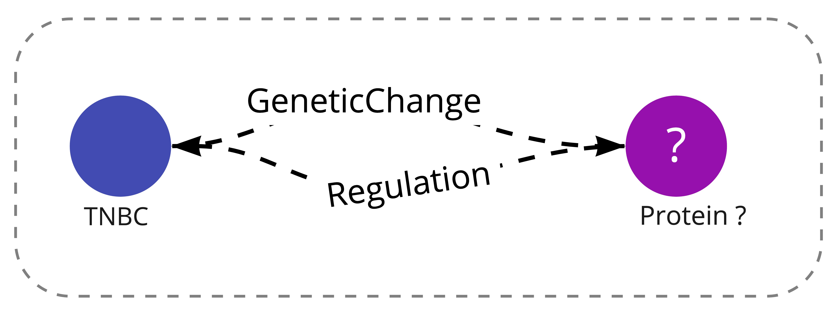
Interpreting ML scores - Validating target predictions with experts
How to validate a “novel” / unseen gene target prediction?
Experts assess plausibility of predicted targets
Model outputs large number of predictions. To shortlist before expert review, infuse biology priors, and reduce ‘desk to lab-bench time’
How did we shortlist?
Reinforce prediction signals -> An ideal gene target should have multiple desired characteristics (Ex: Expression, druggability, mode of action, etc). Obtain intersection of genes predicted to have multiple association routes

Slide 19
Today
1
2
3
4
Background: EpiMap –Why and what
Building KGE models for link Prediction
Results & Challenges in KG ML
Applications and Impact

Slide 20
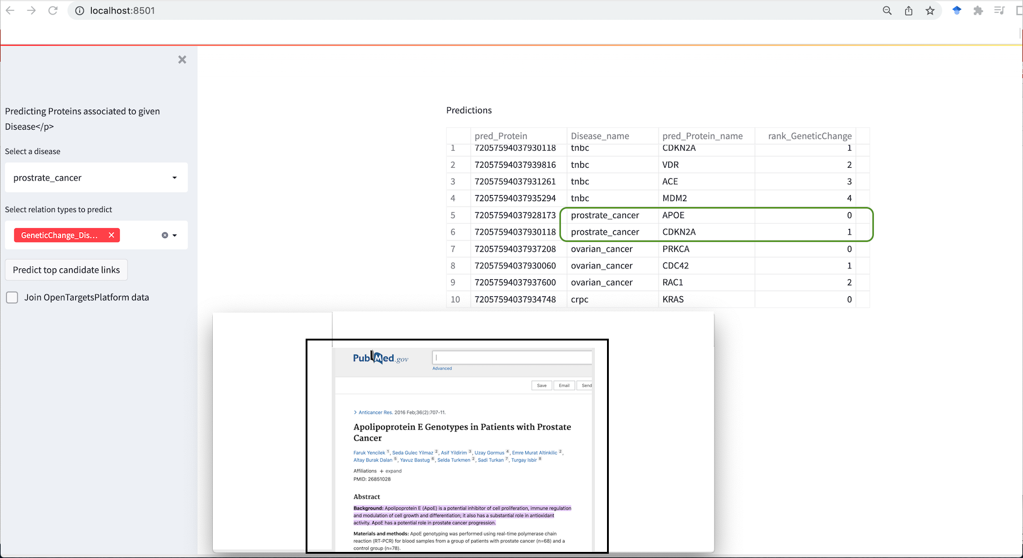
Demo
Quick look at KGE based Link Predictions for Disease Target associations

Slide 21


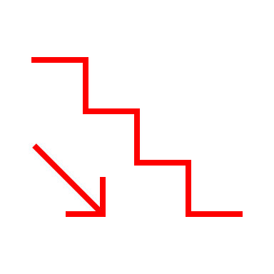
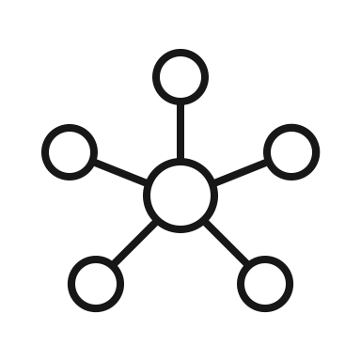

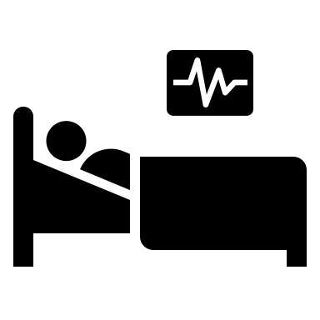


Validation of EpiMap results with AZ knowledge/expertise shows value in Knowledge Graph approach
EpiMap helps reprioritize internal Epigenetic targets
Search
Pan-indication epigenetic signature
Co-location/modulation with drugs of interest
Discover
EpiMap identifies resistance paths in patients treated with PARPi*
Identified established & validated resistance mechanisms Identified >100 testable pathways of drug resistance.
Predict
Expanded our search space by ~10x

Slide 22
Parting note
First text-mined epigenetics Knowledge Graph spanning disease segments, including 13.2M context-specific relationships mined from 7M documents.
Demonstrated that traversable FAIR KGs derived from scientific literature are valuable resources in complex domains, and complementary to scientist’s expertise through the scale and usability they offer.
ML applied to KGs, such as link prediction, can help discover and prioritise potential therapeutic interventions and improve understanding of disease biology, mechanisms of drug resistance, and more.
Nuances in KGE for link prediction
Performance of KGE models affected by many factors: No free lunch!
Predictions are context dependent and infusing biological signals assists scientists in novelty validation.
Validation of ‘novel’ target candidates is hard, but ongoing validation by AstraZeneca experts seems promising
Identified need for ranked hypothesis rather than ranked genes

Slide 23
References
TransE: Bordes, A., Usunier, N., Garcia-Durán, A., Weston, J., & Yakhnenko, O. (2013). Translating Embeddings for Modeling Multi-Relational Data. In Proceedings of the 26th International Conference on Neural Information Processing Systems - Volume 2 (pp. 2787–2795). Red Hook, NY, USA: Curran Associates Inc.
ComplEx: Trouillon, T., Welbl, J., Riedel, S., Gaussier, É., & Bouchard, G. (2016). Complex Embeddings for Simple Link Prediction. arXiv. https://doi.org/10.48550/ARXIV.1606.06357
Ali, M., Berrendorf, M., Hoyt, C. T., Vermue, L., Sharifzadeh, S., Tresp, V., & Lehmann, J. (2021). PyKEEN 1.0: A Python Library for Training and Evaluating Knowledge Graph Embeddings. Journal of Machine Learning Research, 22(82), 1–6. Retrieved from http://jmlr.org/papers/v22/20-825.html
Bonner, S., Barrett, I.P., Ye, C., Swiers, R., Engkvist, O., Hoyt, C.T., Hamilton, W.L.: Understanding the performance of knowledge graph embeddings in drug discovery (2021). https://doi.org/10.48550/ARXIV.2105.10488, https://arxiv.org/abs/2105.10488
Rossi, A., & Matinata, A. (2020). Knowledge Graph Embeddings: Are Relation-Learning Models Learning Relations? In EDBT/ICDT Workshops.
Berrendorf, M., Faerman, E., Vermue, L., Tresp, V.: Interpretable and fair comparison of link prediction or entity alignment methods with adjusted mean rank. arXiv preprint arXiv:2002.06914 (2020)
Berrendorf, M., Faerman, E., Vermue, L., & Tresp, V. (2020). On the Ambiguity of Rank-Based Evaluation of Entity Alignment or Link Prediction Methods. arXiv. https://doi.org/10.48550/ARXIV.2002.06914

Slide 24



<Placeholder for sample tutorial notebook using public data>
Related Work: Also find out more about our AI on KG related research at discoverylab.ai​ or icai.ai/discovery-lab
Want to know more? Drop us a line:
p.mitra@elsevier.com
t.pijnenburg@elsevier.com
t.slater@elsevier.com

